Slide 1

Handwritten Digit Classifier: Logistic Regression & ANN Models
Task 2: Offline Exercises - Train a classification model using scikit-learn or TensorFlow with comprehensive evaluation metrics.

Slide 2
Project Overview
Primary Goal
Evaluation Metrics
Build robust models to accurately classify handwritten digits (0-9) using machine learning techniques.
Comprehensive assessment using Accuracy & F1 Score with confusion matrix analysis and error visualization.
Dual Approach
Method 1: Logistic Regression on Kaggle dataset.
Method 2: Artificial Neural Network on MNIST dataset (Google Colab).

Slide 3

Dataset 1: Kaggle Handwritten Digits
Dataset Characteristics
Source: Kaggle handwritten digits CSV.
Format: 28×28 grayscale images flattened to 784 features.
Labels: Digits 0-9 with balanced distribution.
Split: Strategic train/test division for validation.
Implementation Environment
Developed in Jupyter Notebook using scikit-learn's powerful machine learning toolkit for streamlined model development.

Slide 4



Logistic Regression Model Performance
91%
91%
Accuracy Achieved
F1 Score
Strong baseline performance on digit classification task
Balanced precision and recall confirming model reliability
Sklearn Implementation
Generated Confusion Matrix
Leveraged robust Logistic Regression classifier with optimized hyperparameters.
It shows How well each digit was classified.

Slide 5

Dataset 2: MNIST Benchmark
Industry Standard Dataset
70,000 total images: 60,000 training samples, 10,000 test samples.
28×28 grayscale format - the gold standard for digit recognition benchmarking.
Implementation Platform
Google Colab environment with TensorFlow/Keras framework.

Slide 6

ANN Model Architecture Deep Dive
01
02
Input Layer Design
Hidden Layer Configuration
784 neurons - flattened 28×28 pixel representation capturing full image detail.
Multiple dense layers with ReLU activation functions enabling non-linear pattern recognition.
03
04
Output Layer Structure
Optimization Strategy
10 neurons with softmax activation producing probability distribution across digit classes.
Adam optimizer with categorical crossentropy loss for multi-epoch training convergence.

Slide 7

ANN Model: Superior Performance Results
98%
98%
Test Accuracy
F1 Score
Exceptional performance on MNIST test set
High precision & recall consistency
The ANN model demonstrated significant improvement over logistic regression, showcasing the power of deep learning for complex pattern recognition tasks.
Comprehensive confusion matrix analysis and visualization of misclassified digits enabled thorough error analysis and model understanding.

Slide 8


Model Comparison & Performance Analysis
Model Type
Dataset
Environment
Accuracy
F1 Score
Logistic Regression
Kaggle
Jupyter Notebook
91%
~0.91
Neural Network (ANN)
MNIST
Google Colab
98%
~0.98
ANN Advantages
Dataset Impact
Deeper learning capacity captures complex non-linear digit patterns and features.
MNIST's standardized preprocessing contributed to superior results.

Slide 9








Key Insights & Technical Learnings
Baseline Effectiveness
Deep Learning Power
Logistic regression provides solid foundation for digit classification with interpretable results and fast training.
ANN's multi-layer architecture significantly boosts accuracy by capturing complex nonlinear patterns.
Dataset Importance
Robust Evaluation
Quality preprocessing and standardized datasets like MNIST dramatically impact model performance.
Multiple metrics (accuracy, F1 score, confusion matrix) ensure comprehensive model assessment.

Slide 10


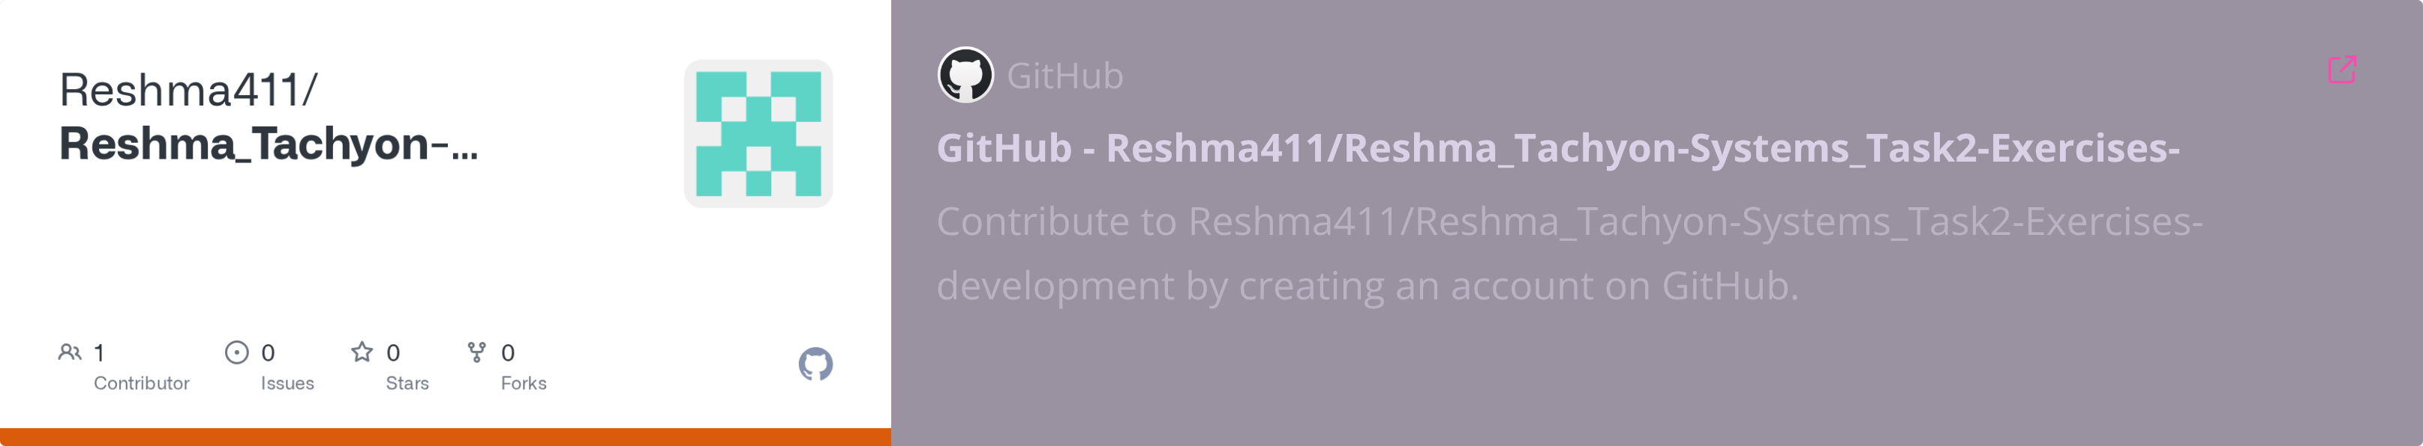
Thank You!
Questions & Discussion Welcome
Ready to discuss methodology, results, and potential improvements or applications.
Repository Access

